Slide 1

Software requirements (swr302)
Requirements from the customer’s perspective (Chapter 02)

Slide 2
Contents
The expectation gap
Who is the customer
The customer-development partnership
Requirements Bill of Rights for Software Customers
Requirements Bill of Responsibilities for Software Customers
Creating a culture that respects requirements
Identifying decision makers
Reaching agreement on requirements

Slide 3
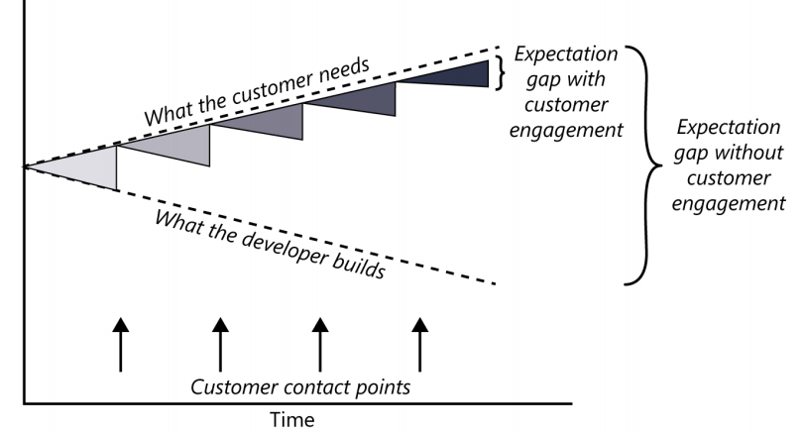
The expectation gap

Slide 4
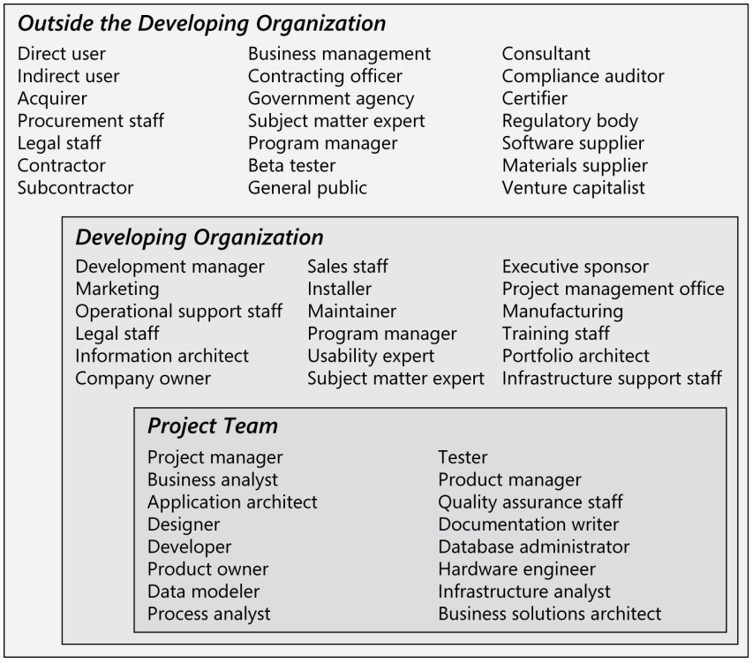
Who is the customer?
A customer is an individual or organization that derives either direct or indirect benefit from a product.
Software customers could request, pay for, select, specify, use, or receive the output generated by a software product
Notes:
Direct user, indirect user, executive sponsor, procurement staff, and acquirer

Slide 5
The customer-development partnership – the rights
Customers have the right to:
Expect BAs to speak your language.
Expect BAs to learn about your business and your objectives.
Expect BAs to record requirements in an appropriate form.
Receive explanations of requirements practices and deliverables.
Change your requirements.
Expect an environment of mutual respect.
Hear ideas and alternatives for your requirements and for their solution.
Describe characteristics that will make the product easy to use.
Hear about ways to adjust requirements to accelerate development through reuse.
Receive a system that meets your functional needs and quality expectations.
Notes:
Teacher should explain every the right of customers in requirements engineering activities

Slide 6
The customer-development partnership – the responsibilities
Customers have the responsibility to:
Educate BAs and developers about your business.
Dedicate the time that it takes to provide and clarify requirements.
Be specific and precise when providing input about requirements.
Make timely decisions about requirements when asked.
Respect a developer’s assessment of the cost and feasibility of requirements.
Set realistic requirement priorities in collaboration with developers.
Review requirements and evaluate prototypes.
Establish acceptance criteria.
Promptly communicate changes to the requirements.
Respect the requirements development process
Notes:
Teacher should explain every the responsibility of customers in requirements engineering activities

Slide 7
Creating a culture that respects requirements
Engage people in a collaborative requirements partnership
Users to provide requirements input makes it more likely that they’ll get what they needs
Developers ought to recognize that participating in the process will make their lives easier than being hit on the head by whatever requirements document flies over the proverbial wall
How to create a culture that respects requirements
Resisters
Developers
QA & testers
The organization’s leadership

Slide 8
Identifying decision makers 1/2
There can be hundreds of decisions to make
resolve some conflict
accept (or reject) a proposed change
approve a set of requirements for a specific release
…
We need to determine who the requirements decision makers will be and how they will make decisions.
The decision-making group needs to identify its decision leader and to select a decision rule, which describes how they will arrive at their decision

Slide 9
Identifying decision makers 2/2
Decision rules
The decision leader makes the choice, either with or without discussion with others.
The group votes and the majority rules.
The group votes, but the result must be unanimous to approve the decision.
The group discusses and negotiates to reach a consensus. Everyone can live with the decision and commits to supporting it.
The decision leader delegates authority for making the decision to one individual.
The group reaches a decision, but some individual has veto authority over that decision.
Notes:
Veto authority: quyền phủ quyết

Slide 10
Reaching agreement on requirements
Reaching agreement on the requirements for the product to be built, or for a specific portion of it, is at the core of the customer-developer partnership. Multiple parties are involved in this agreement:
Customers agree that the requirements address their needs.
Developers agree that they understand the requirements and that they are feasible.
Testers agree that the requirements are verifiable.
Management agrees that the requirements will achieve their business objectives.
The requirements baseline
What if you don’t reach agreement?
Agreeing on requirements on agile projects

Slide 11


